Slide 1
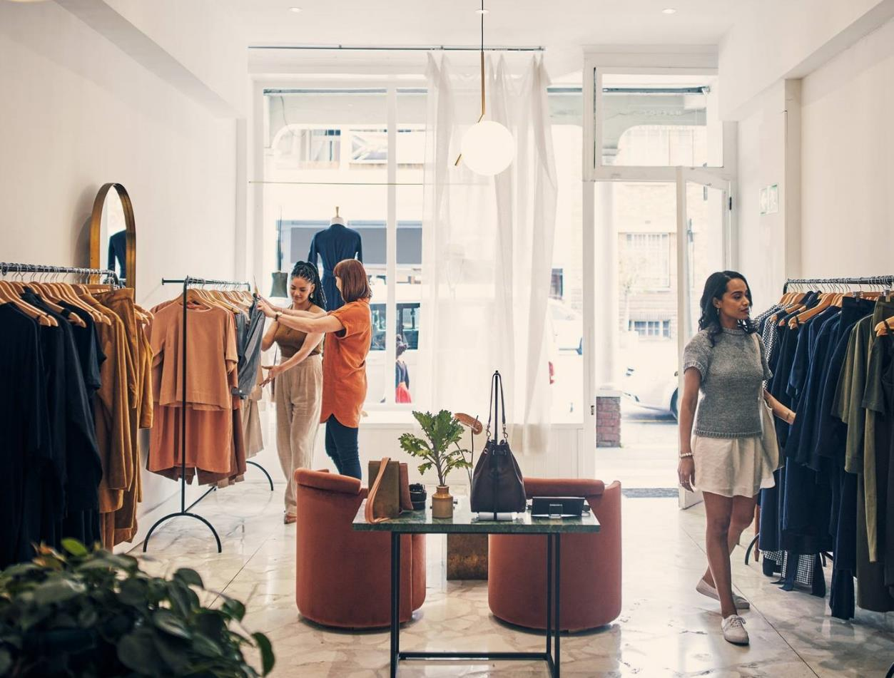
MULTIKART

Slide 2
Mehak Garg Muskan Choudhary
TEAM MEMBERS

Slide 3
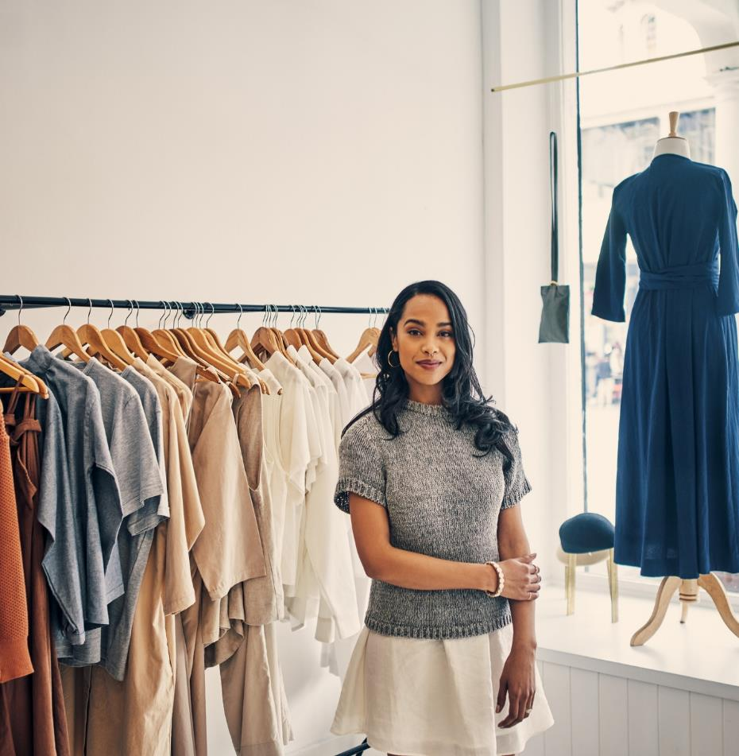
Introduction
Welcome to MULTIKART our e-commerce platform, your ultimate destination for buying clothes from a variety of brands! Our website brings together a curated collection of clothing items, ranging from casual wear to formal attire, and everything in between. With a focus on quality, style, and diversity, we offer a seamless shopping experience where you can explore and purchase clothing from renowned brands all in one place. Whether you're looking for trendy streetwear, classic staples, or exclusive designer pieces, we've got you covered. Start browsing now to discover the latest fashion trends and elevate your wardrobe with top-notch brands.

Slide 4



TECHNOLOGIES USED
Frontend
Backend
Database
Angular
Java Spring Boot
Mongodb

Slide 5
MODULES
Home page
Product
Wishlist
Where User Will First Land
All the Available Products
Product that you Like are added to your collection

Slide 6

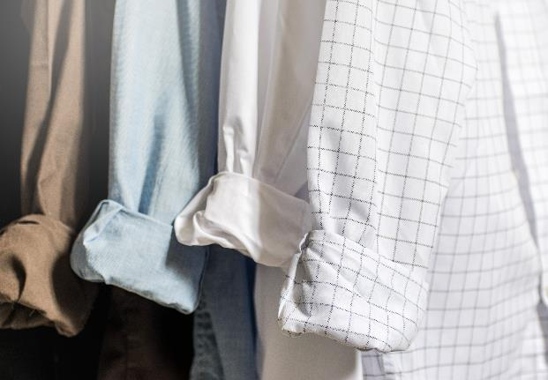
Cart
Product you wish to buy now or in Future
Order
Proceed the product from Cart to Payment
Payment
To buy you must Pay via Available Payment Methods

Slide 7

Benefits
1.
Simple and efficient to use
2.
Wide Range of Brands
3.
Variety of Products

Slide 8
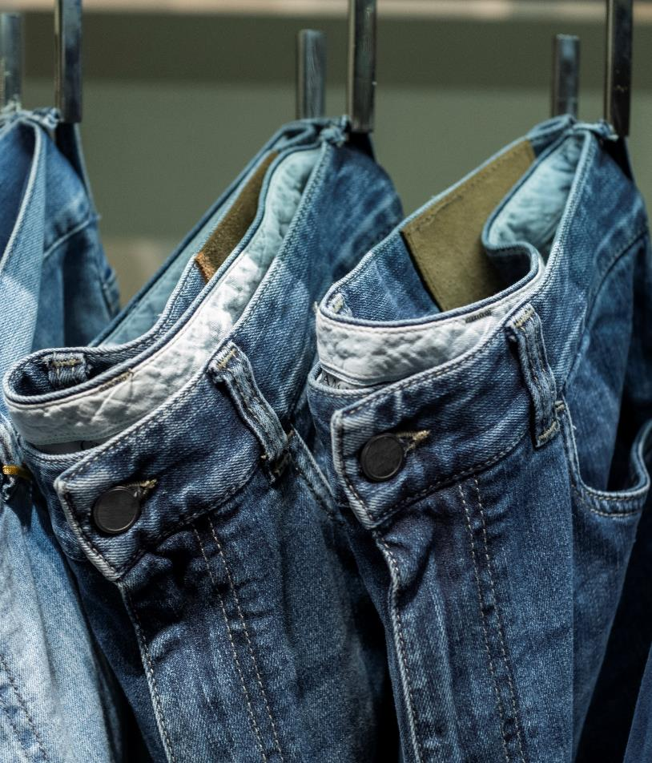
Customer Reviews and Ratings
Exclusive Deals and Discounts
Secure Transactions
User-Friendly Interface

Slide 9
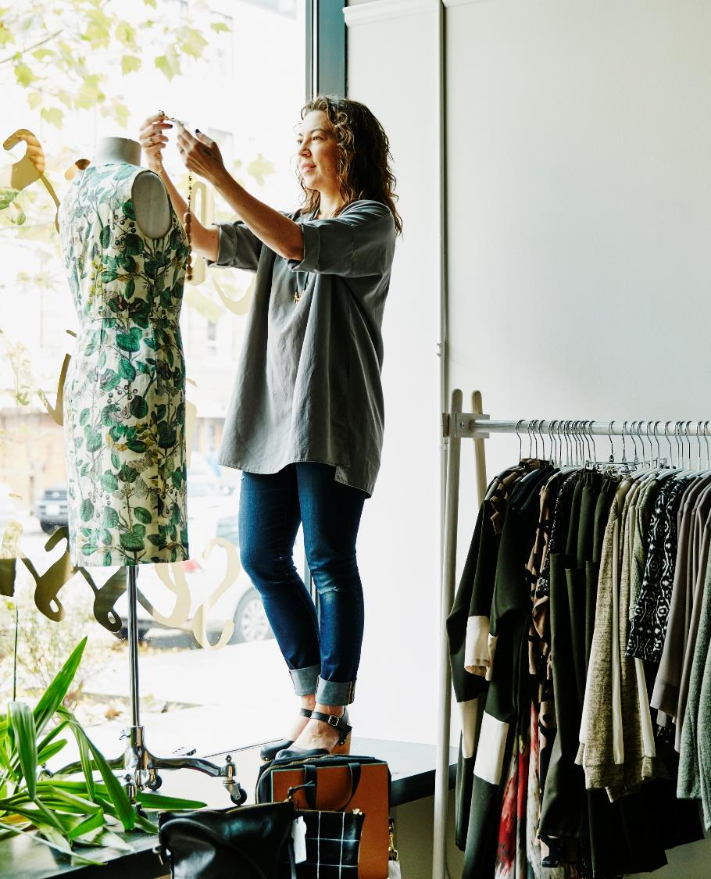
CONCLUSION
It is an e-commerce website that provides users with a seamless shopping experience, offering a vast range of products, convenient navigation, secure payment options, personalized recommendations, and efficient order tracking.

Slide 10
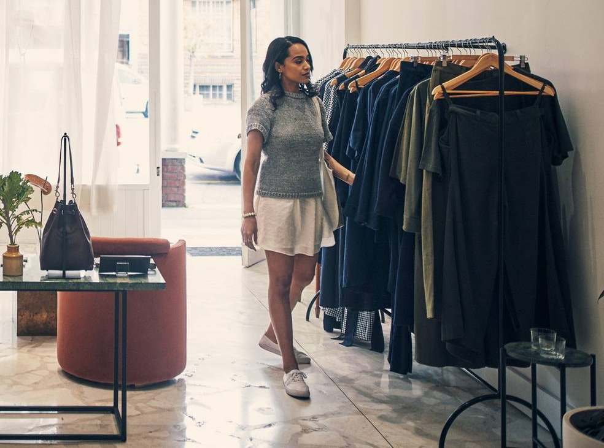
Thank you

